Slide 1
Ground and Surface Water Rights
Eric Geiger, Peoples Company

Slide 2
Ground Water Rights
Ground water rights came along as mineral rights, if you owned the land above your property, you own the water below it.
As irrigation districts came into development, reservoirs were formed along a system fed by canals originating from the rivers. In this example, I will use what I am familiar with and that is the Platte River.

Slide 3
North and South Platte River
Both originate in Colorado
North flows into and through Wyoming, where other rivers originating in Wyoming flow into the North Platte, then into and through Nebraska
South flows into Denver and meets with the North near North Platte Nebraska.
Lake McConaughy is the North Platte River (2nd largest hydraulic fill dam in the World)
Capacity of 1,740,000 acre feet of water

Slide 4
Diversions
Gothenburg Ditch
Cozad Ditch
Orchard and Alfalfa
Lexington Ditch
30-Mile Canal
Kearney Ditch
Tri-County Canal

Slide 5
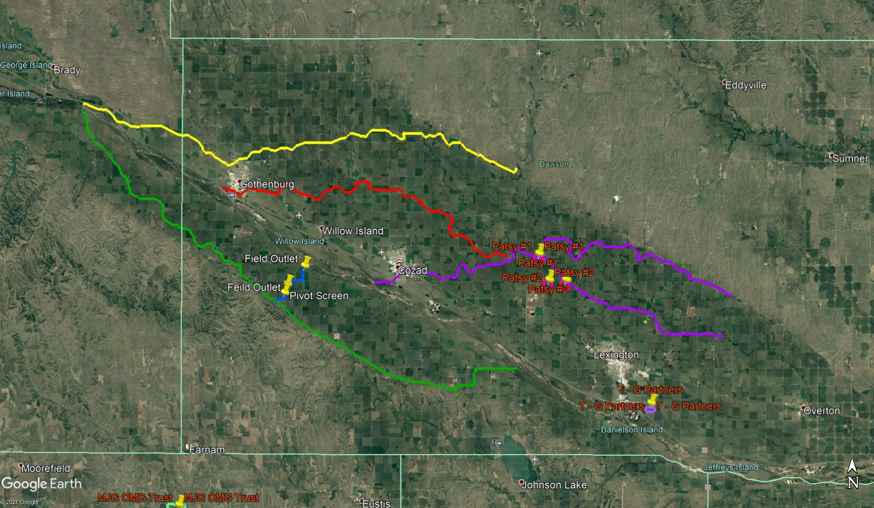
4 Canal Systems, as example

Slide 6
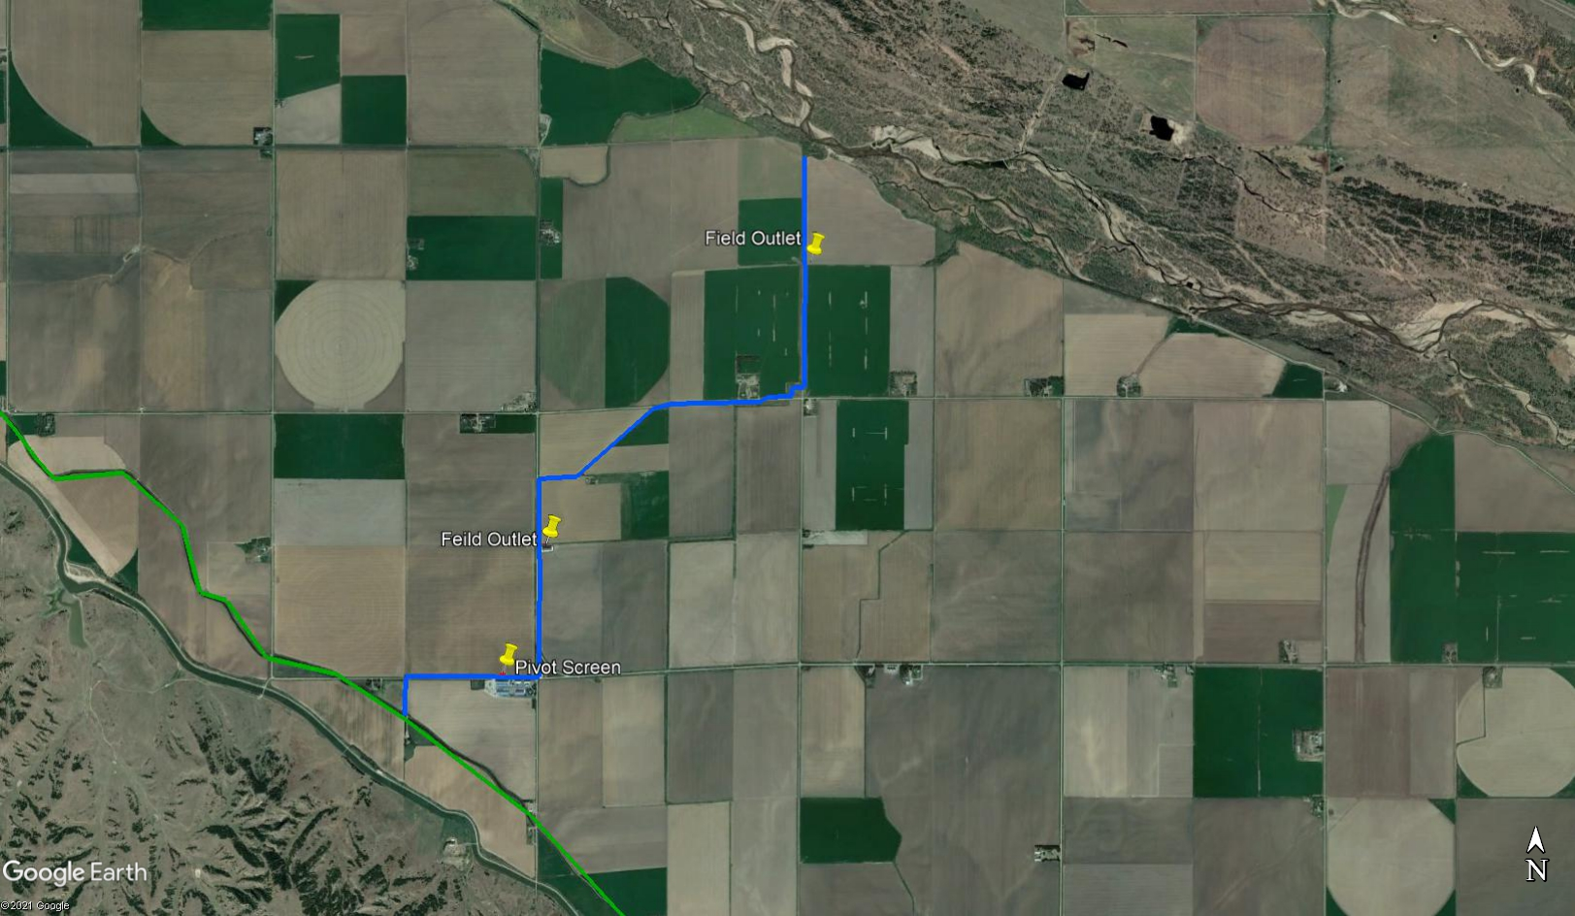
Field Service Lateral

Slide 7
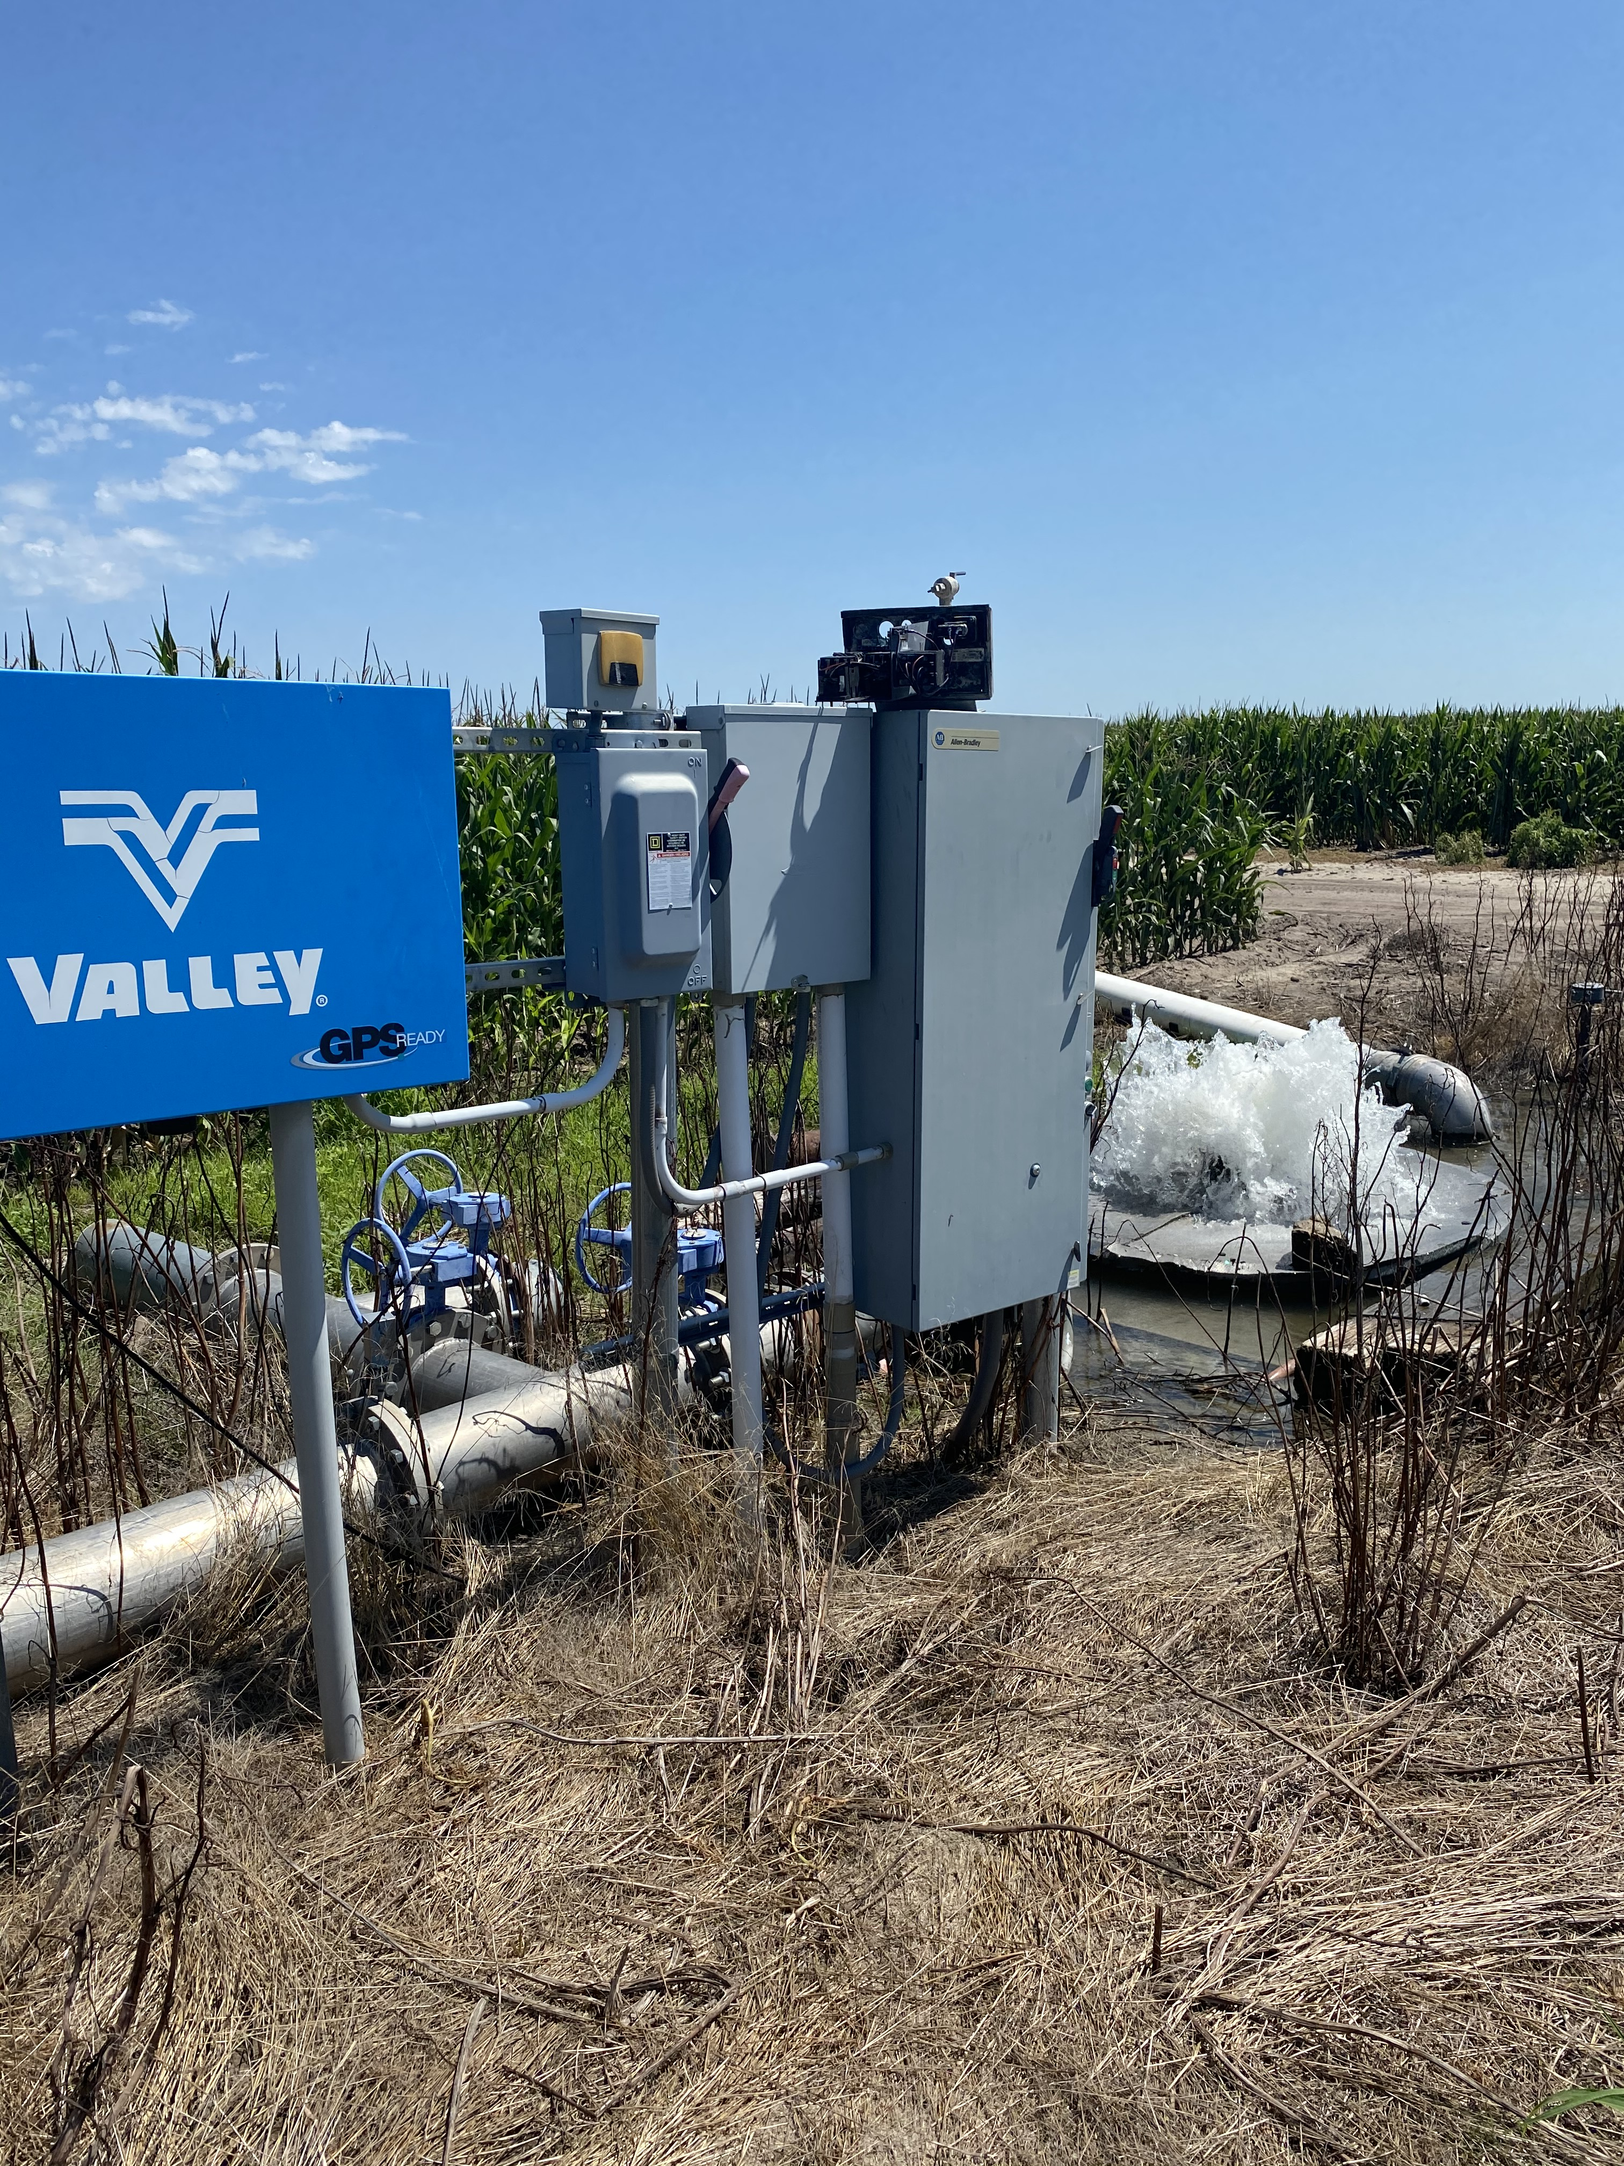

Slide 8
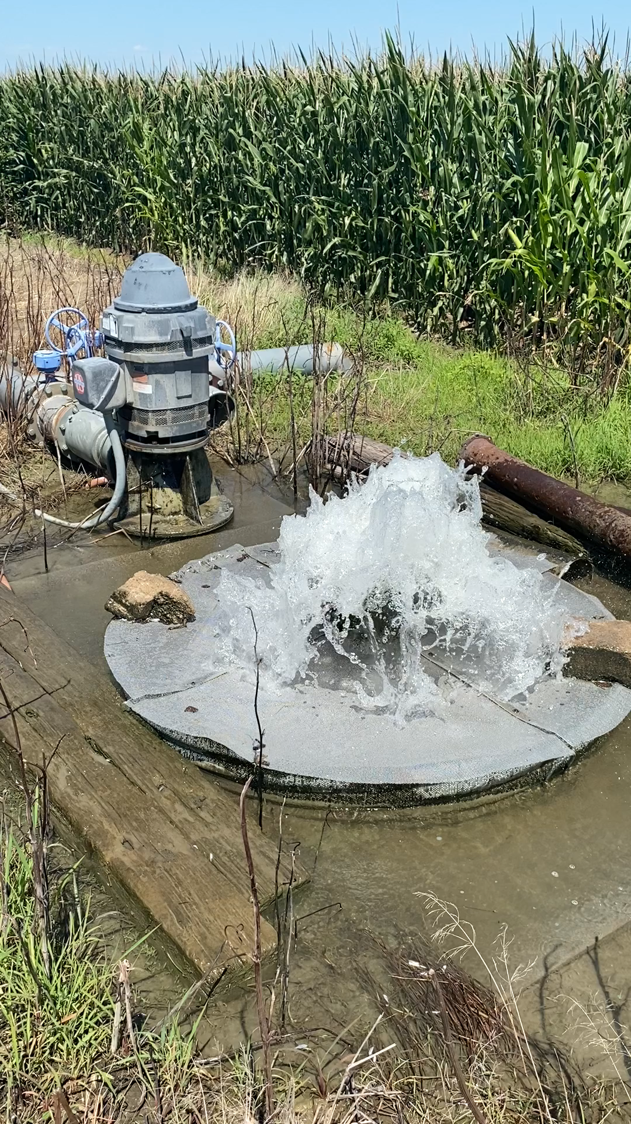

Slide 9
Surface Water Rights
As Ditches were put into use, the rule for water rights is, first in use first in line.
Water rights were purchased as a way for help fund the ditches, a holder received 1 acre foot of water for each right. If you have 80 acres of water right, you can irrigate 80 acres with 1 foot on each acre.
Some farms have both, ground water and surface water rights

Slide 10
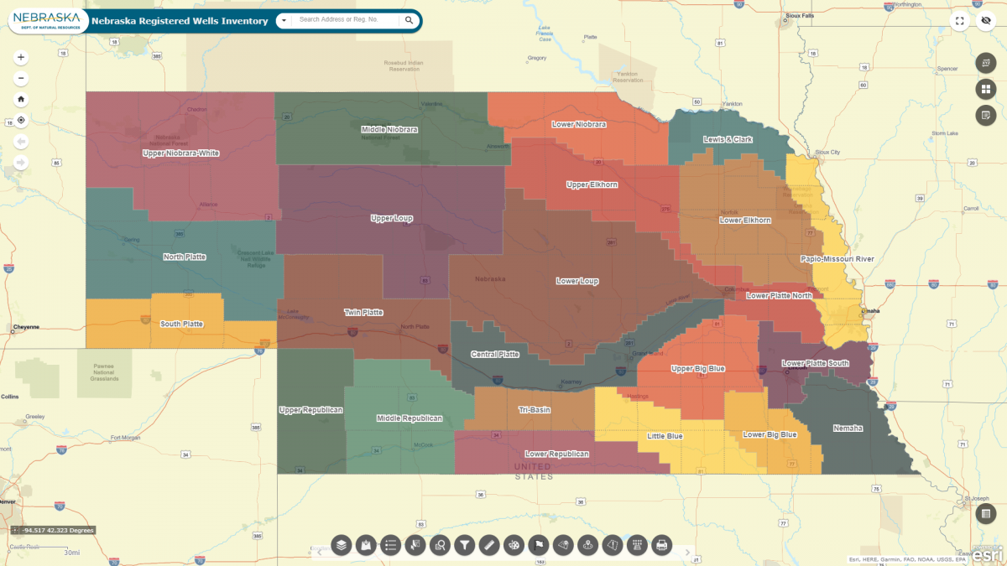

Slide 11
Appropriation of Water Rights
23 Natural Resource Districts
Conserve and protect Nebraska’s natural resources
Funded by property taxes
They oversee the appropriation of water rights and regulate the use of ground and surface water
Over appropriation, more land approved for use of water than there is water, mainly surface, but ground water comes into play also.

Slide 12
Well drilling and appropriation guidelines
Moratoriums on newly irrigated acres
Moratoriums on drilling new wells
Allowed to drill replacement wells

Slide 13
Water availability effects on farmland values
Least to Most listed in order:
No limitations, full appropriation
Limited application of 12” per year per acre (1 acre foot), full appropriation
Limited application of 1 acre foot, limited number of acres certified irrigated
Limited application of 9 inches per acre/year, full appropriation
Limited application of 9 inches per acre/year, limited number of acres certified irrigated
Dryland farm with possibility of adding wet acres
Dryland farm with out possibility of adding wet acres

Slide 14
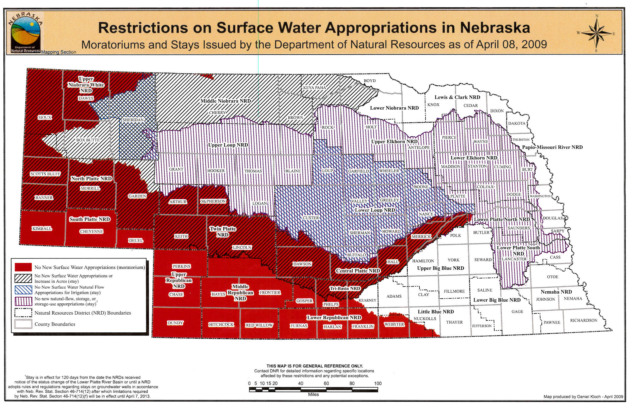
Surface Water Appropriations

Slide 15
Connection with surface water and ground water
Most directly connected are rivers and managed reservoirs.
Second is irrigation canals, irrigation laterals, creeks and flood control reservoirs
Third are any natural water holding or drainage routes

Slide 16
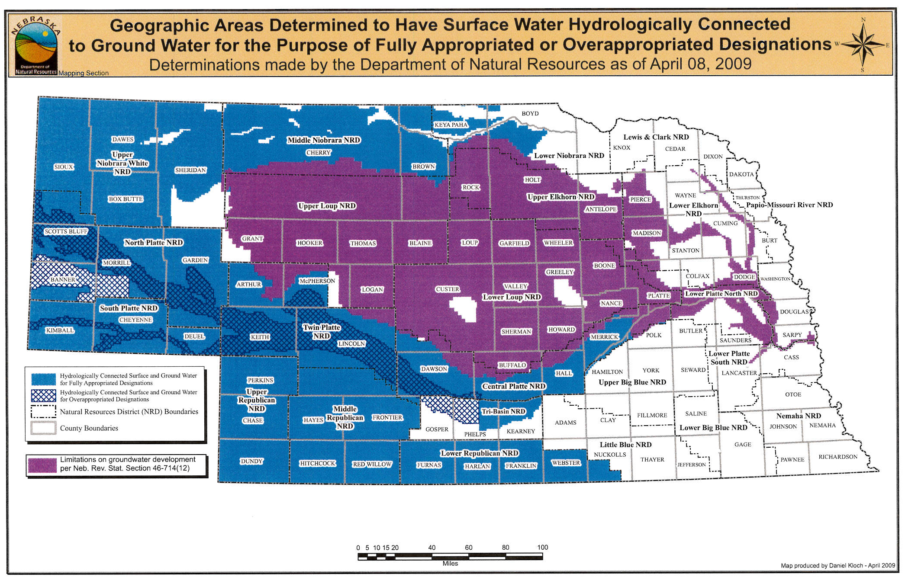
Connection with surface water and ground water

